Slide 1




NEXT GEN EMPLOYABILITY PROGRAM
Creating a future-ready workforce
Team Members
College Name
Student Name : KESAVARAJ J
Student ID :110321104023
Nm ID: au110321104023
Email: kesavarajj04@gmail.com
1103-GRT Institution of Engineering and technology,Tiruttani

Slide 2

CAPSTONE PROJECT SHOWCASE
Project Title
MUSIC WEB APPLICATION USING DJANGO FRAMEWORK
Abstract | Problem Statement | Project Overview | Proposed Solution | Technology Used | Modelling & Results | Conclusion

Slide 3
Abstract
The project presents the development of a Music Web Application using the Django framework. The application integrates various technologies including HTML, CSS, JavaScript, Bootstrap for the front-end interface, and Python with Django for the back-end functionalities.
The aim of the project is to provide users with a platform to access and manage their music collection efficiently. The application allows users to create accounts, upload and organize their music files, create playlists, and explore new music based on their preferences.
The Django framework facilitates the implementation of user authentication, database management, and efficient handling of HTTP requests. The front-end interface is designed to be intuitive and user-friendly, enhancing the overall user experience.
Through this project, we demonstrate the capabilities of Django framework in building robust and scalable web applications, particularly in the context of managing multimedia content like music.

Slide 4
Problem Statement
The project addresses the need for a personalized and flexible music management platform amidst the limitations of existing solutions. Users often face challenges managing their music collections efficiently across various devices and platforms.
Existing services may lack customization options or fail to meet users' organizational needs. Additionally, privacy concerns and the preference for self-hosted solutions drive the demand for an alternative.
To tackle these issues, the project proposes developing a Music Web Application using the Django framework. This application will offer users features such as account creation, music uploading, organization, playlist creation, and personalized music discovery.
By leveraging front-end technologies like HTML, CSS, JavaScript, and Bootstrap alongside Django's robust back-end capabilities, the project aims to deliver a comprehensive solution that caters to music enthusiasts' diverse needs.

Slide 5
Project Overview
The project entails the creation of a Music Web Application using the Django framework, which is a powerful Python-based web framework known for its simplicity and scalability. The application's front-end will be developed using HTML, CSS, JavaScript, and Bootstrap, ensuring a visually appealing and responsive user interface.
Utilizing Django's robust back-end capabilities, the application will ensure secure user authentication, efficient database management, and seamless handling of HTTP requests.
Ultimately, the project aims to address the limitations of existing music management solutions by providing users with a comprehensive, customizable, and user-friendly platform and the application will bridge the gap between user requirements and existing solutions, offering a seamless and efficient music management experience.

Slide 6
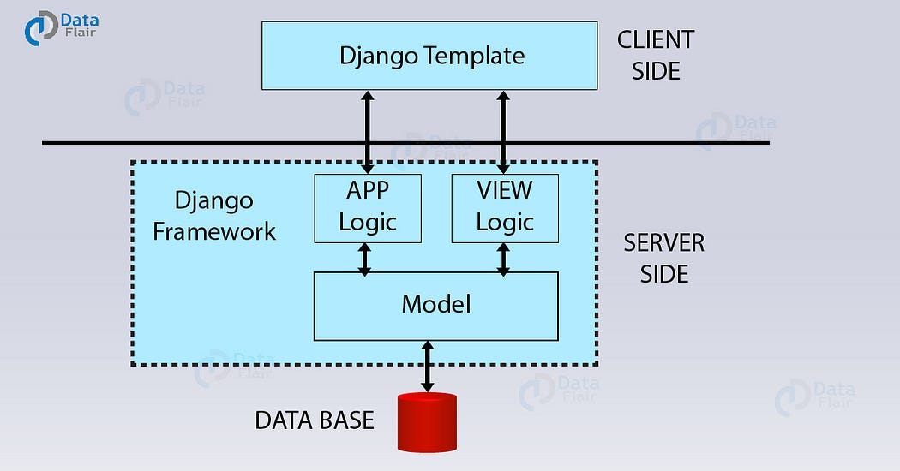
Working structure:

Slide 7
Proposed Solution
1.Django Framework:
Django is a high-level Python web framework that simplifies the process of building web applications by providing pre-built components and conventions. It offers features like user authentication, database management with its ORM (Object-Relational Mapping), URL routing, and template engine. These features are crucial for developing a complex application like a music web app, as they handle tasks such as user management, data storage, and routing requests from the client to the server.
2.Front-end Technologies (HTML, CSS, JavaScript, Bootstrap):
HTML (HyperText Markup Language), CSS (Cascading Style Sheets), JavaScript, and Bootstrap are fundamental technologies for building the user interface of web applications. HTML structures the content of web pages, CSS styles the appearance, JavaScript adds interactivity and dynamic behavior, and Bootstrap provides pre-designed UI components and responsive layout utilities. Together, these technologies ensure the creation of an attractive, responsive, and user-friendly interface for the music web application.
.

Slide 8
3.User Account Management:
User account functionalities enable users to register, log in securely, and manage their profiles. This allows for a personalized experience where users can customize their music collections, preferences, and settings. User authentication ensures that only authorized users can access their accounts and data, enhancing security and privacy.
4.Music Uploading and Organization:
Allowing users to upload their music files to the application and organize them into categories or playlists facilitates efficient management and retrieval of music. This feature enhances user convenience by providing a centralized platform for storing and accessing their music collections.
5.Playlist Creation:
Enabling users to create custom playlists based on their preferences allows for personalized music curation. Users can group songs according to mood, genre, or any other criteria, enhancing their control over their listening experience and promoting engagement with the application.

Slide 9
6.Personalized Music Discovery:
Implementing features for personalized music discovery, such as recommendations based on user listening history, preferences, or similar users' choices, enhances user engagement and satisfaction. By suggesting new music that aligns with users' tastes, the application encourages exploration and introduces users to fresh content they may enjoy.
7.Secure Authentication and Data Management:
Ensuring secure authentication mechanisms, such as encryption and secure storage of user credentials, protects user accounts from unauthorized access. Additionally, employing robust data management practices, such as encryption of stored music files and adherence to data privacy regulations, helps safeguard user data from breaches or unauthorized access, enhancing trust and confidence in the application.
Overall, the proposed model bridges the gap between existing limitations of music management solutions and users' preferences for a customizable, efficient, and secure platform. With its combination of innovative features and reliable technology stack, the Music Web Application promises to deliver a seamless and enjoyable music management experience for users.

Slide 10


Technology Used
Front-end
Back-end
Source :

Slide 11
Modelling & Results
The modeling phase of the project likely involves designing the database schema using Django's ORM (Object-Relational Mapping) to represent entities such as users, music files, playlists, and user preferences to involve designing the user interface using wireframes or mockups to visualize the layout and functionality of the application.
This would include defining relationships between these entities, such as one-to-many relationships between users and playlists, and many-to-many relationships between playlists and music files.
The results of the project would typically include a fully functional Music Web Application implemented using Django and front-end technologies like HTML, CSS, JavaScript, and Bootstrap. Users would be able to create accounts, upload music files, organize them into playlists, and discover new music based on their preferences.
The application would also include features for secure user authentication, database management, and responsive UI design. The success of the project would be measured based on factors such as user satisfaction, system performance, and adherence to project requirements and deadlines.

Slide 12
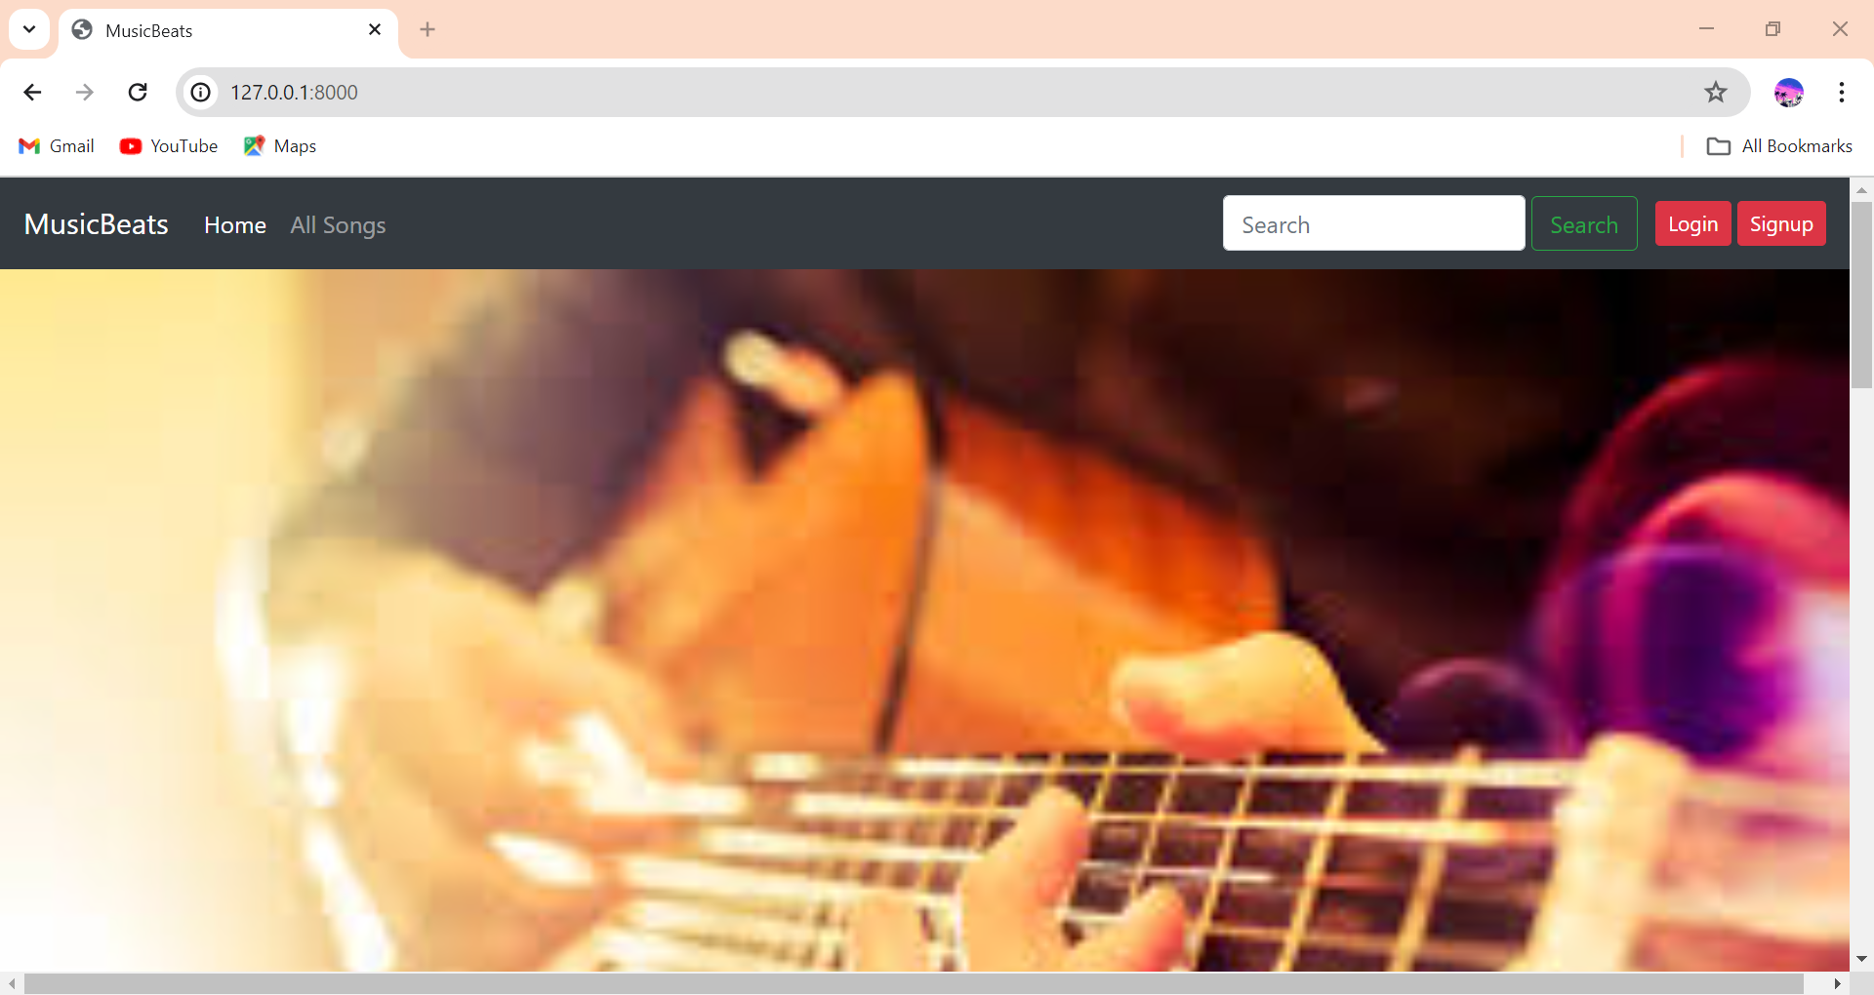
Homepage

Slide 13
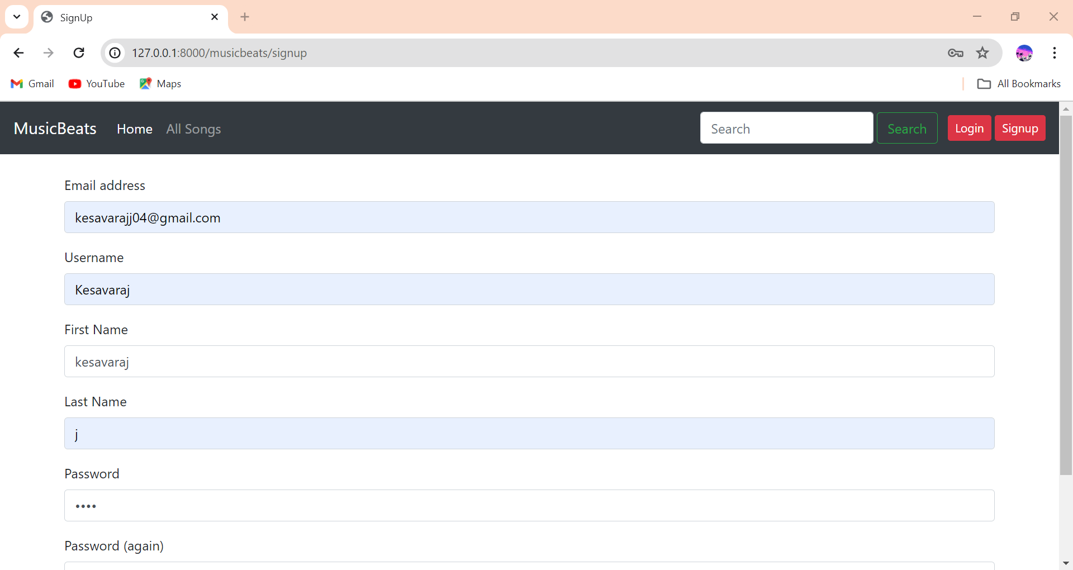
Sign-up

Slide 14
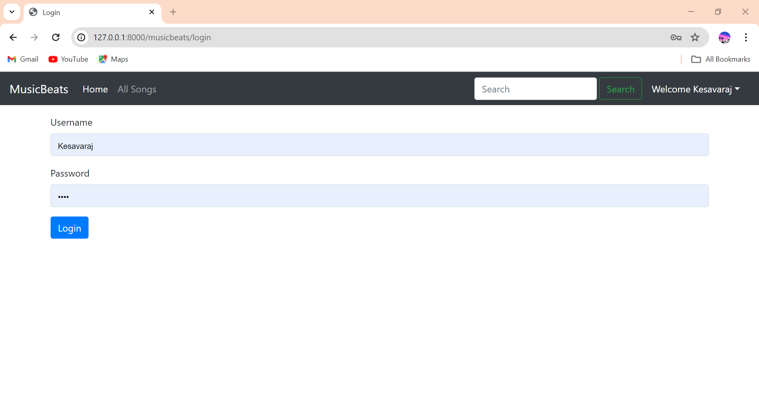
Login

Slide 15
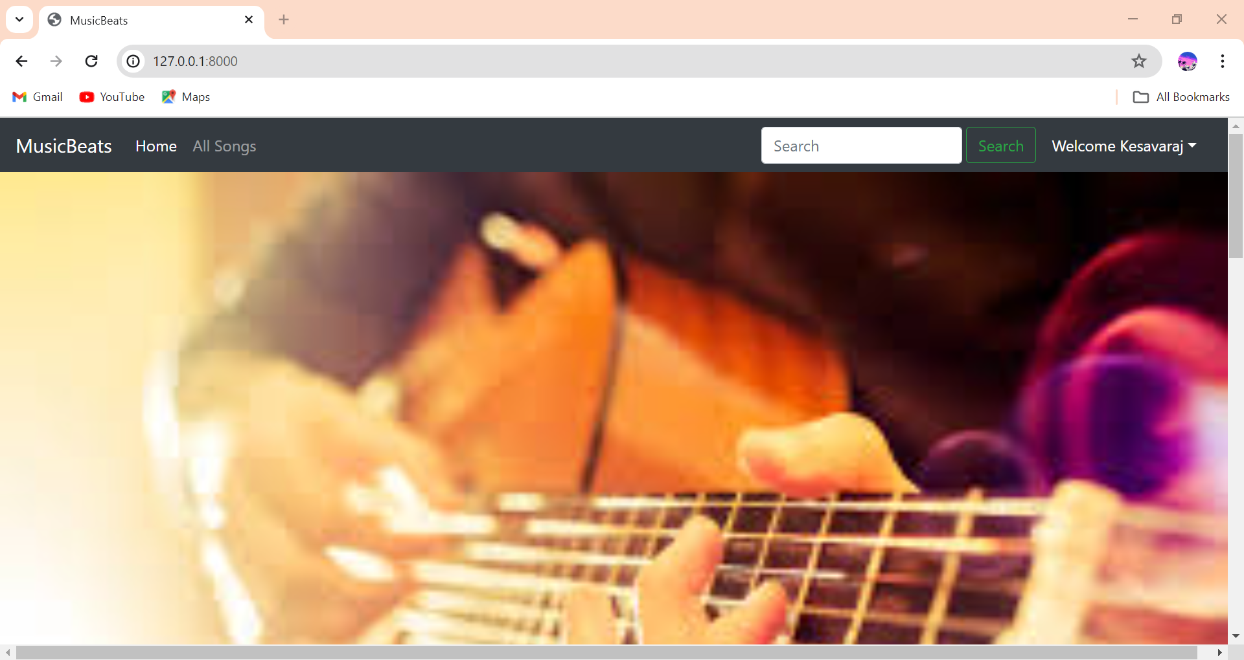
After login

Slide 16
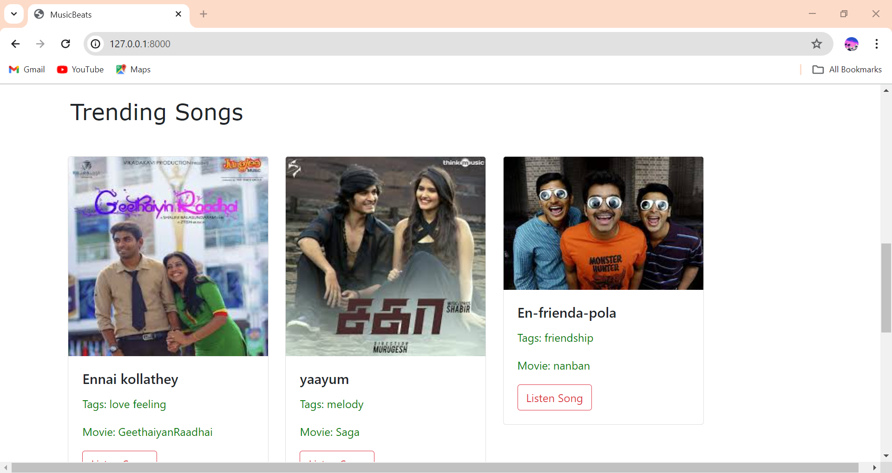
Trending songs

Slide 17
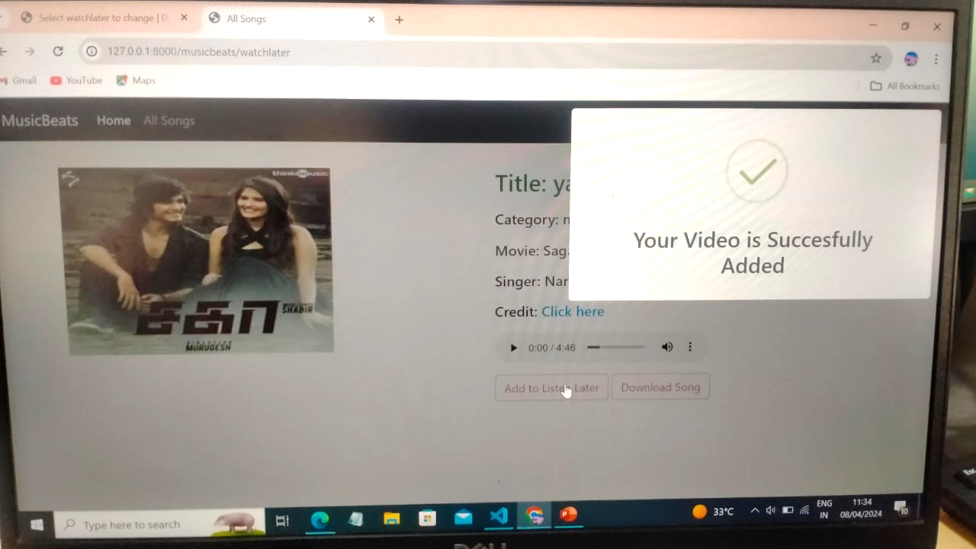
Add to listen later

Slide 18
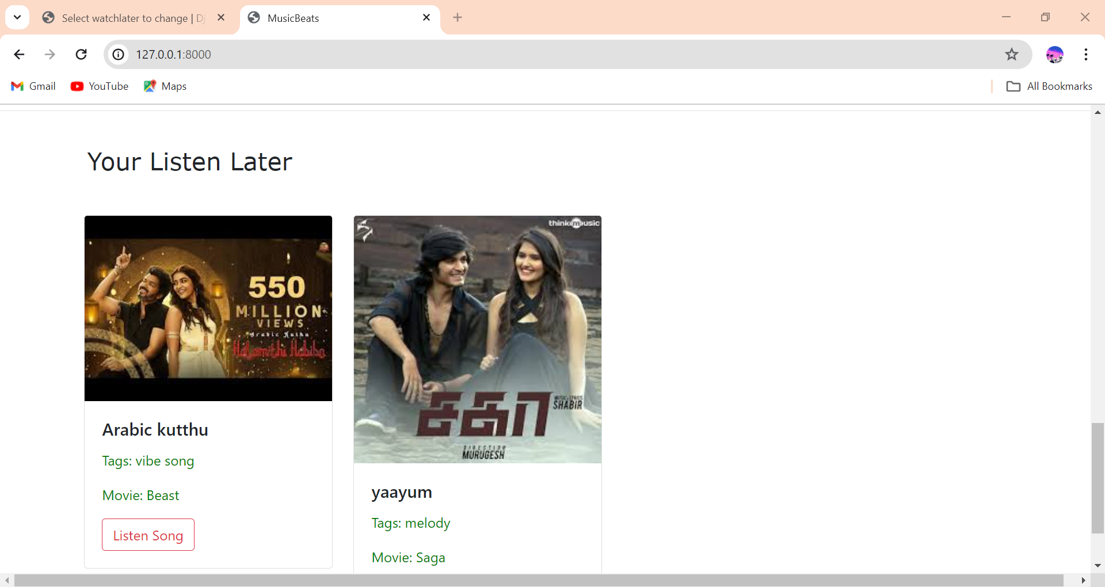
listen later songs

Slide 19
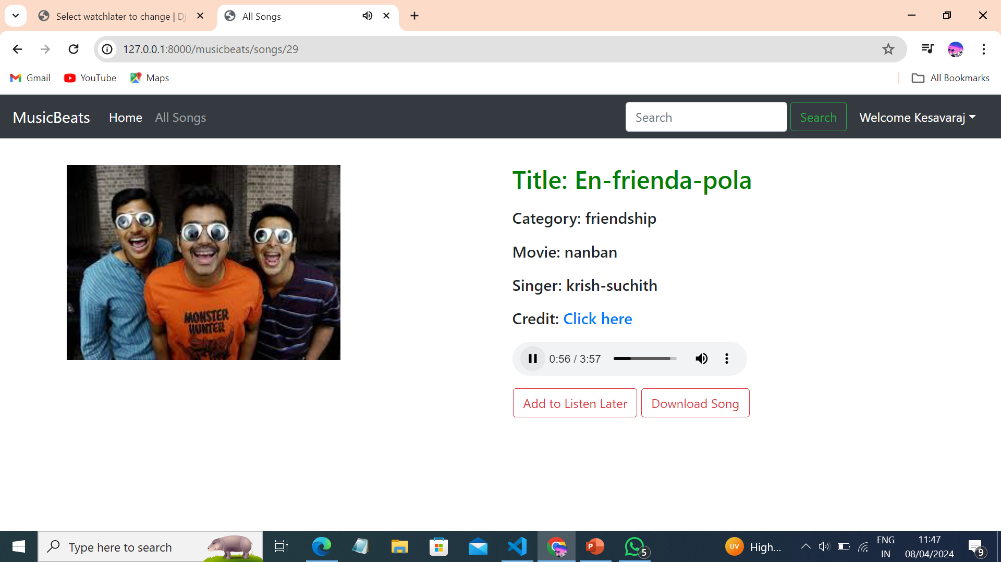
Songs to listen

Slide 20
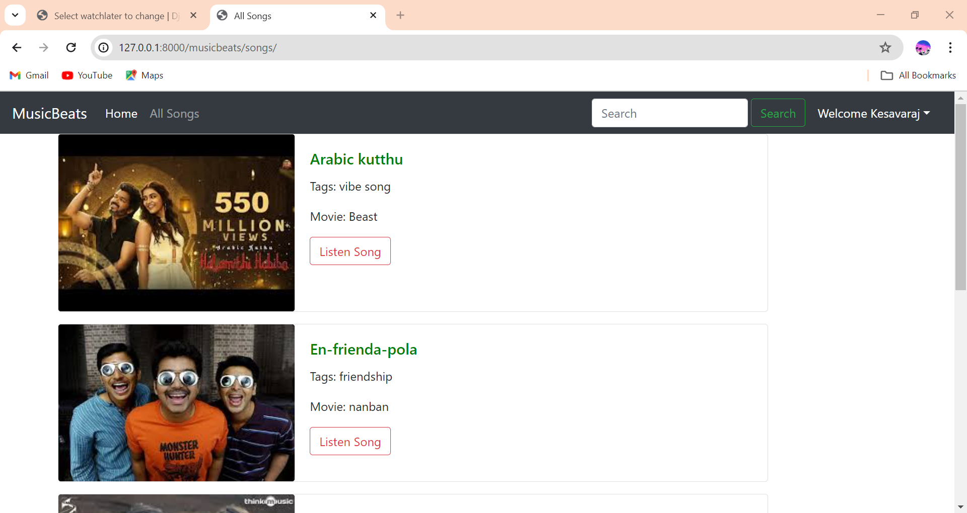
All songs

Slide 21
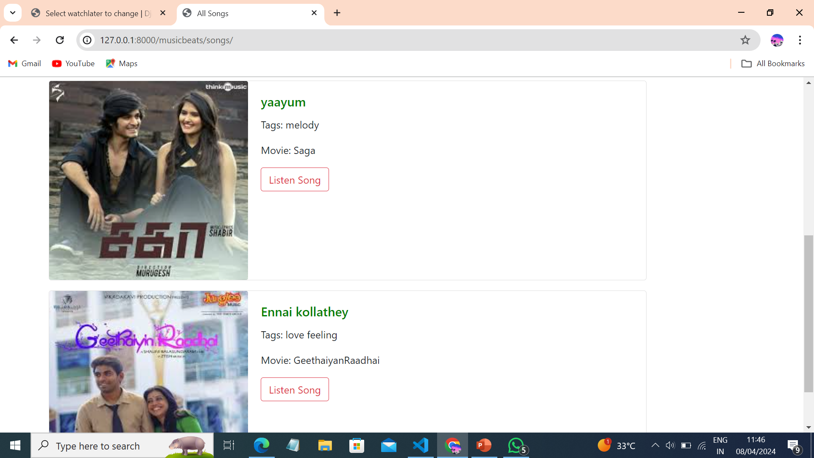

Slide 22
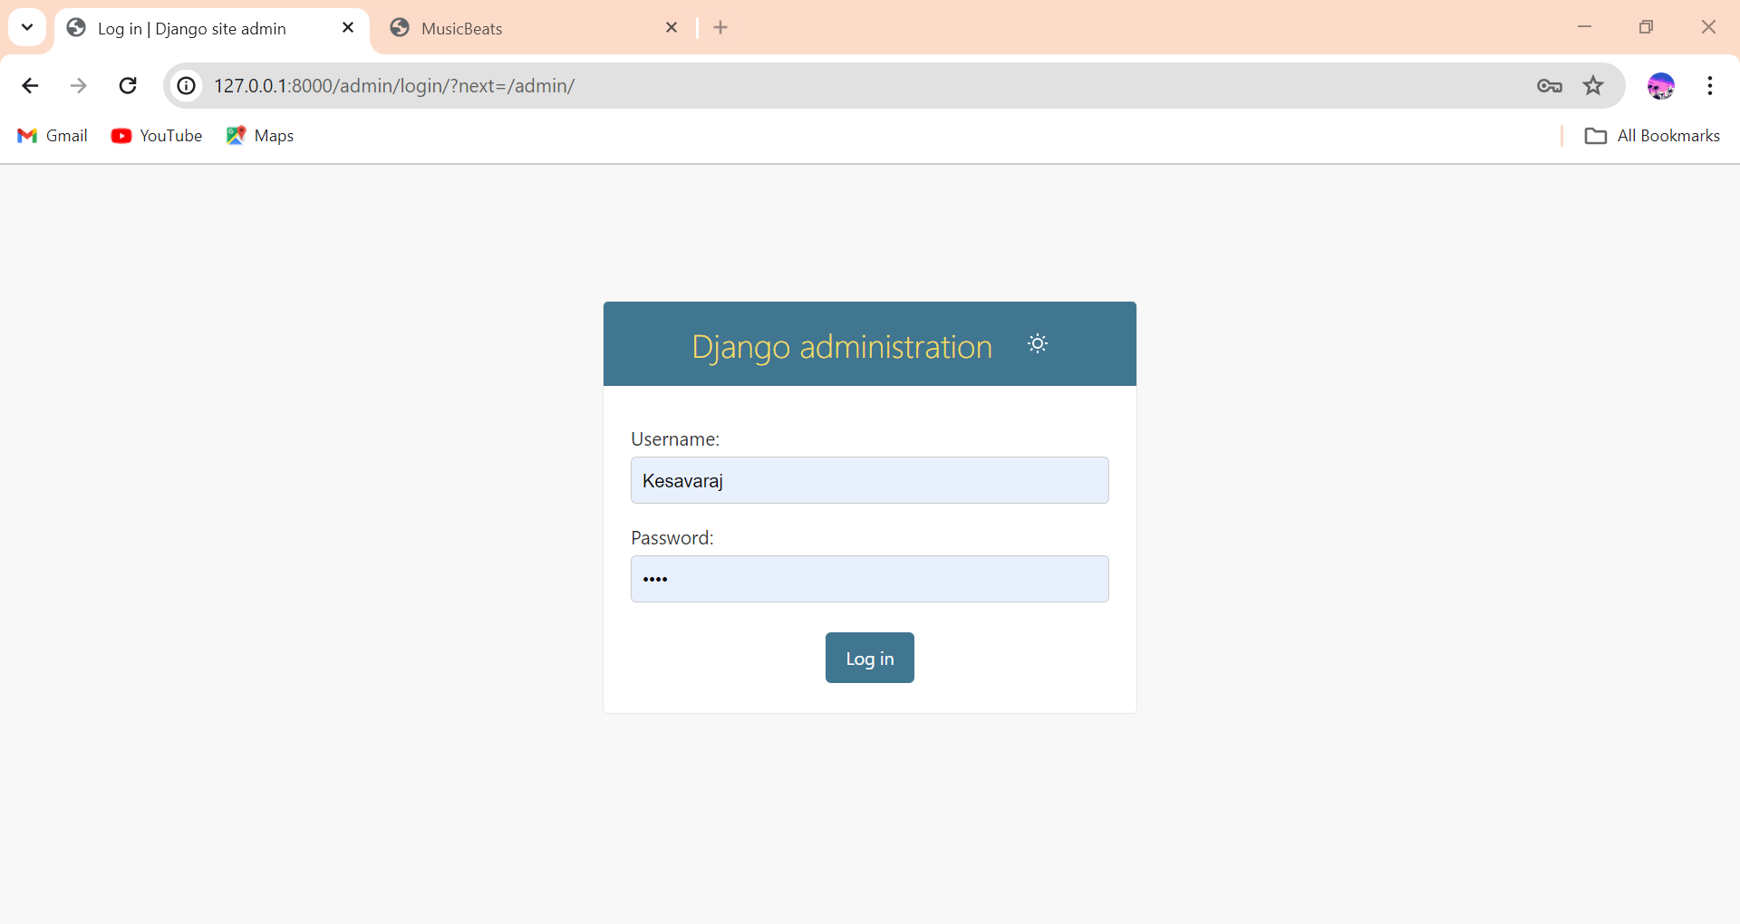
Django framework

Slide 23
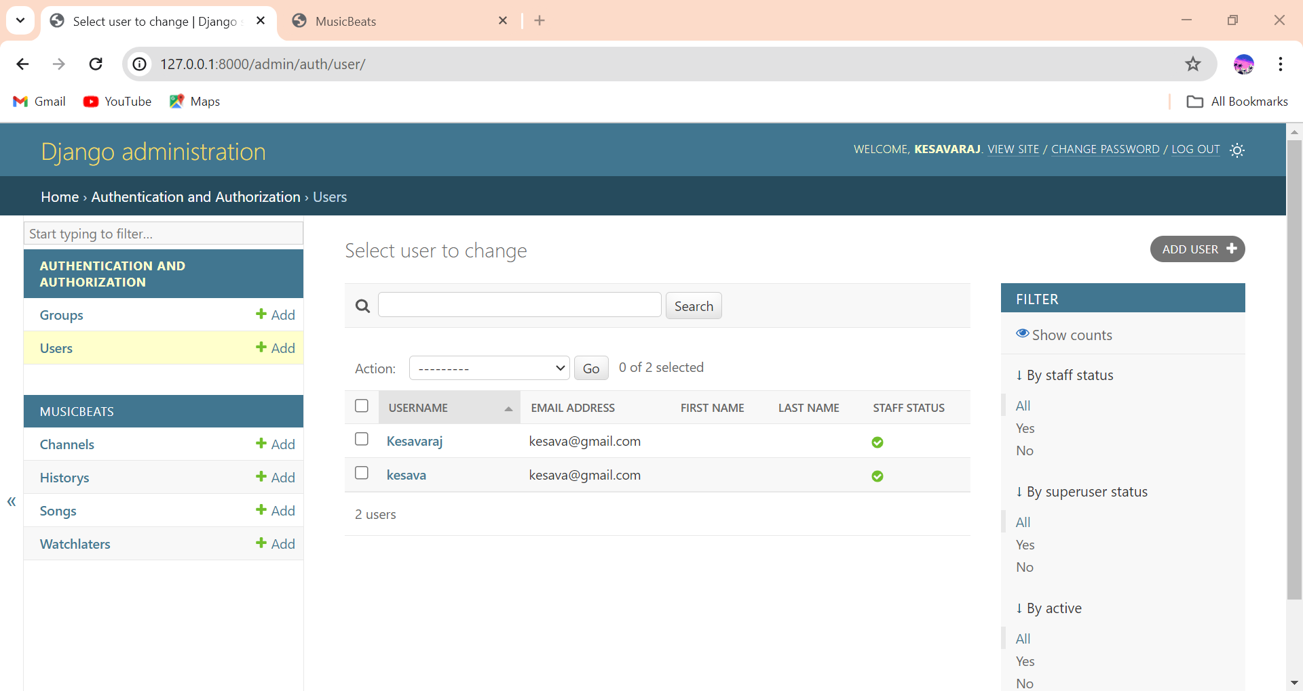
User

Slide 24
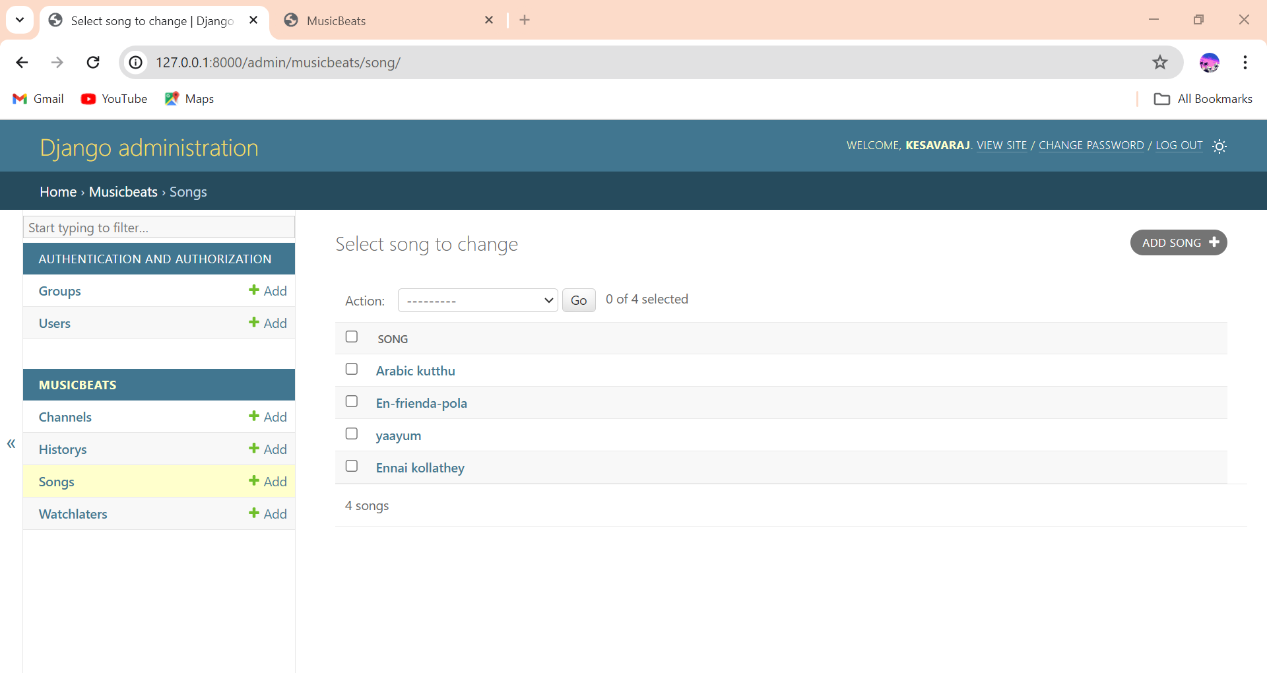
songs

Slide 25
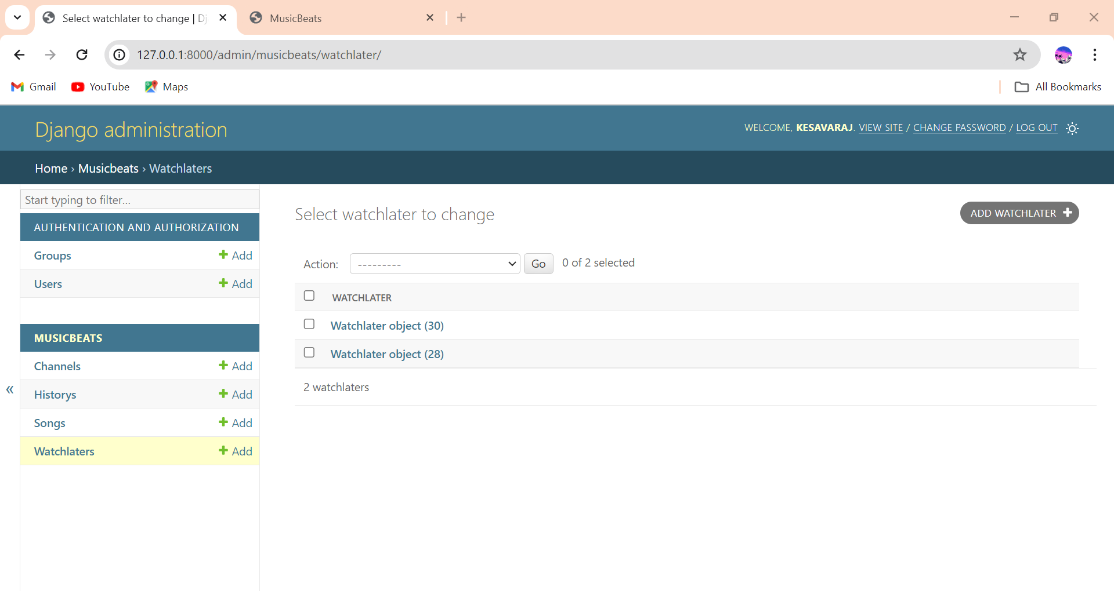
Watchlater

Slide 26
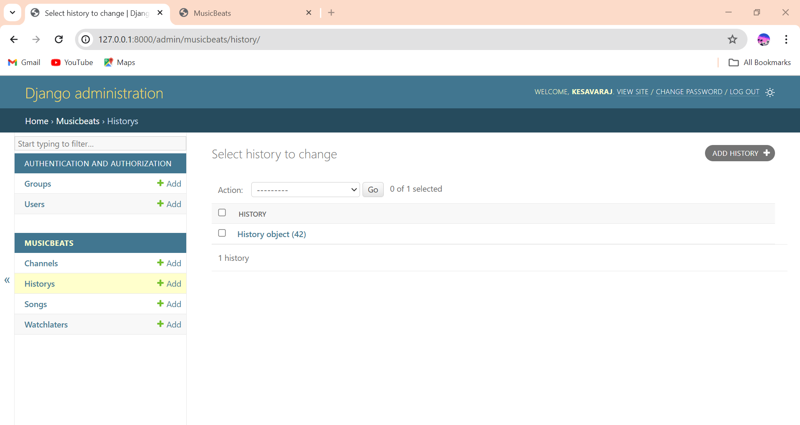
History

Slide 27
Future Enhancements:
Enhanced Recommendation System:
Implement machine learning algorithms to improve personalized music recommendations based on user preferences, listening history, and behavior patterns.
2.Social Integration:
Integrate social media platforms to allow users to share their playlists, favorite songs, and music discoveries with friends, enhancing social interaction and engagement within the application.
3.Live Streaming and Events:
Introduce features for live streaming of music events, concerts, and radio stations, providing users with access to real-time music experiences and promoting community engagement.
4.Voice Control and Gesture Recognition:
Integrate voice control and gesture recognition functionalities to offer hands-free interaction with the application, enhancing accessibility and user convenience, particularly in situations where manual input may be impractical

Slide 28
Conclusion
The Music Web Application developed using the Django framework represents a significant advancement in digital music management. By seamlessly integrating front-end technologies like HTML, CSS, JavaScript, and Bootstrap with Django's powerful back-end capabilities, the application offers users a comprehensive and intuitive platform for organizing, discovering, and enjoying music.
Features like account management, music organization, and personalized recommendations cater to diverse user preferences. Looking ahead, potential enhancements include social integration and advanced recommendation algorithms to further enrich the user experience.
It bridges the gap between existing limitations of music management solutions and users' preferences for a customizable, efficient, and secure platform. With its combination of innovative features and reliable technology stack, the Music Web Application promises to deliver a seamless and enjoyable music management experience for users

Slide 29
Thank You!
Notes:
Thank You !!

